Slide 1
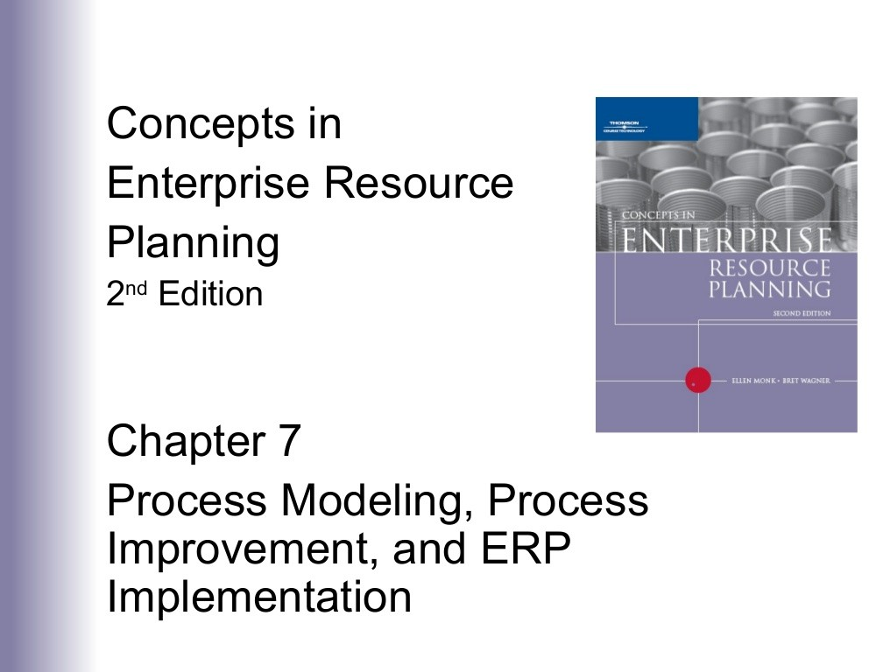

Slide 2
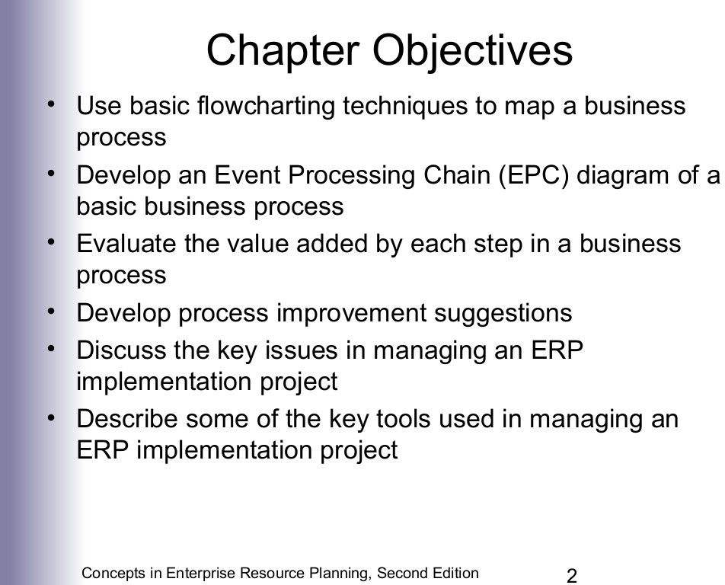

Slide 3
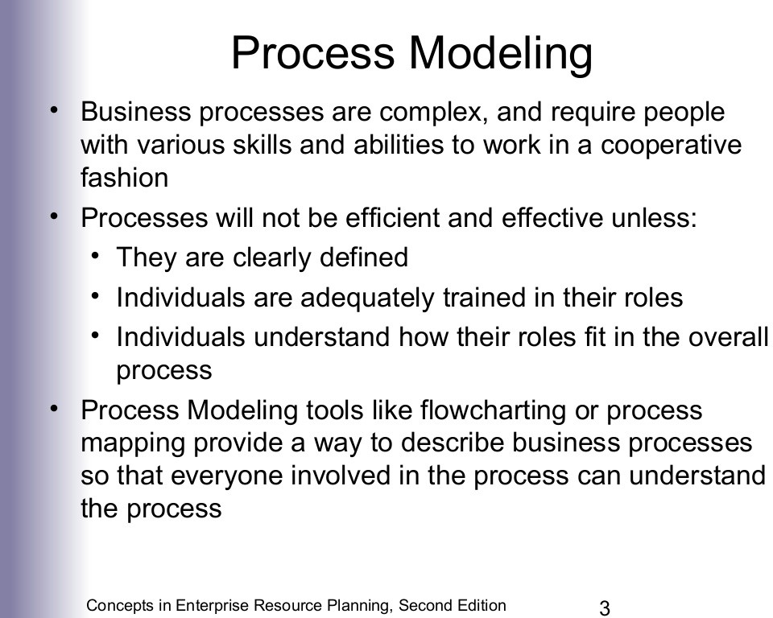

Slide 4
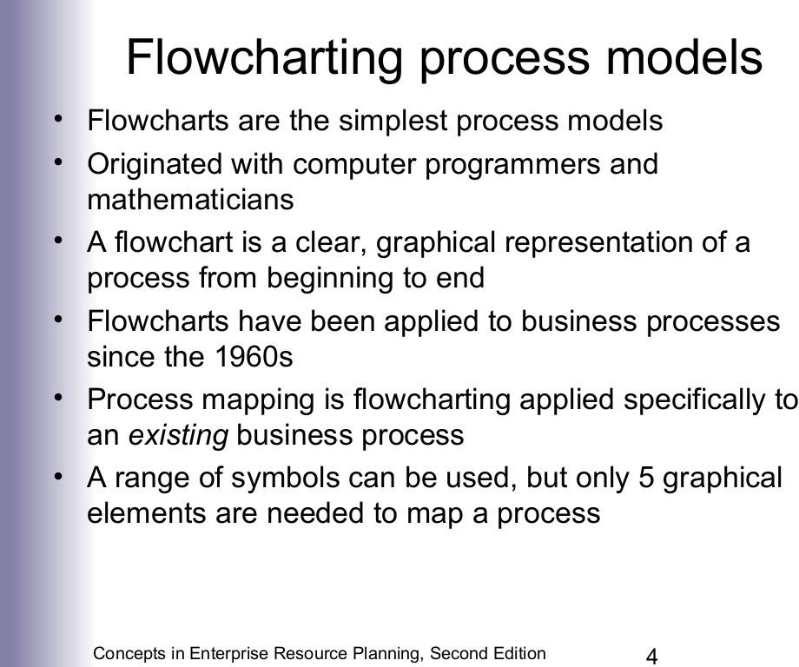

Slide 5
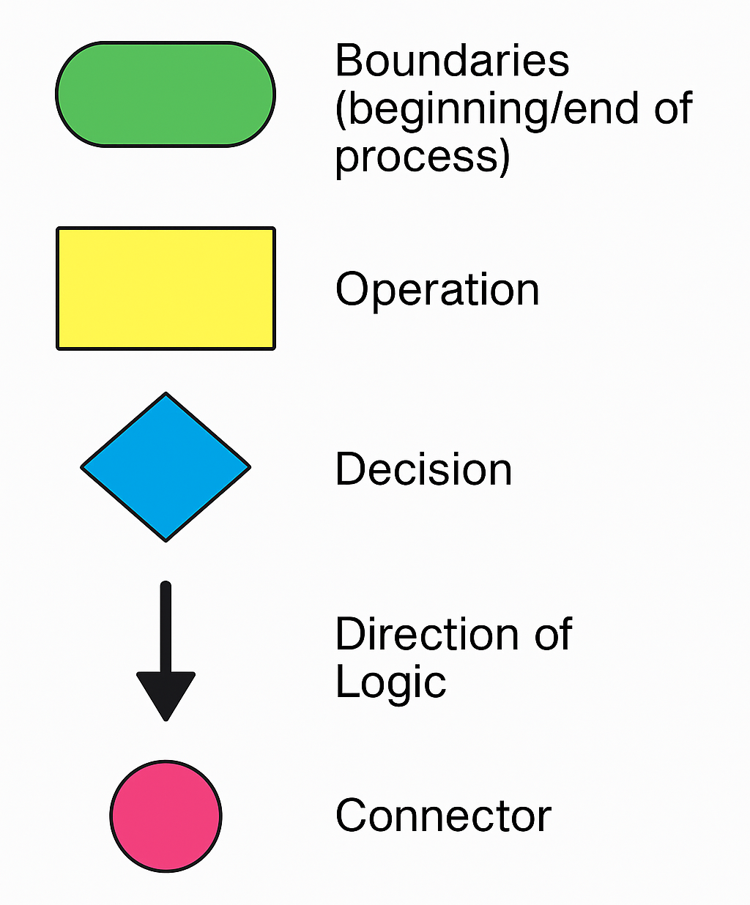
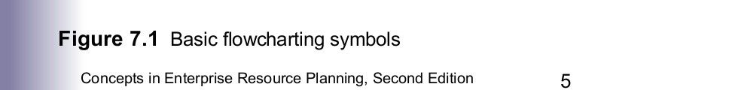

Slide 6
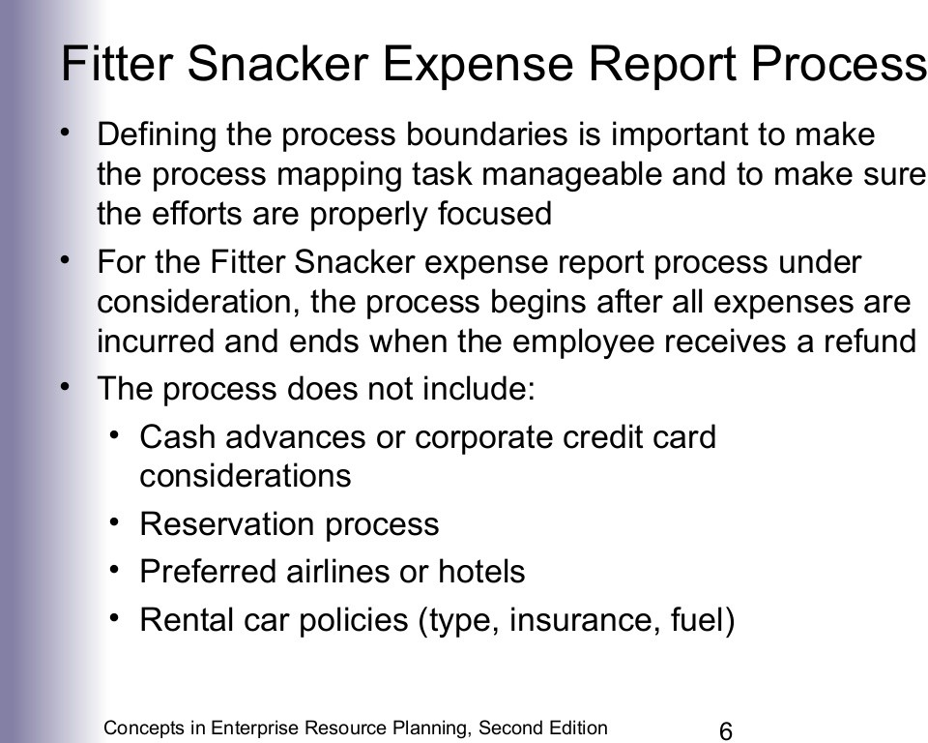

Slide 7
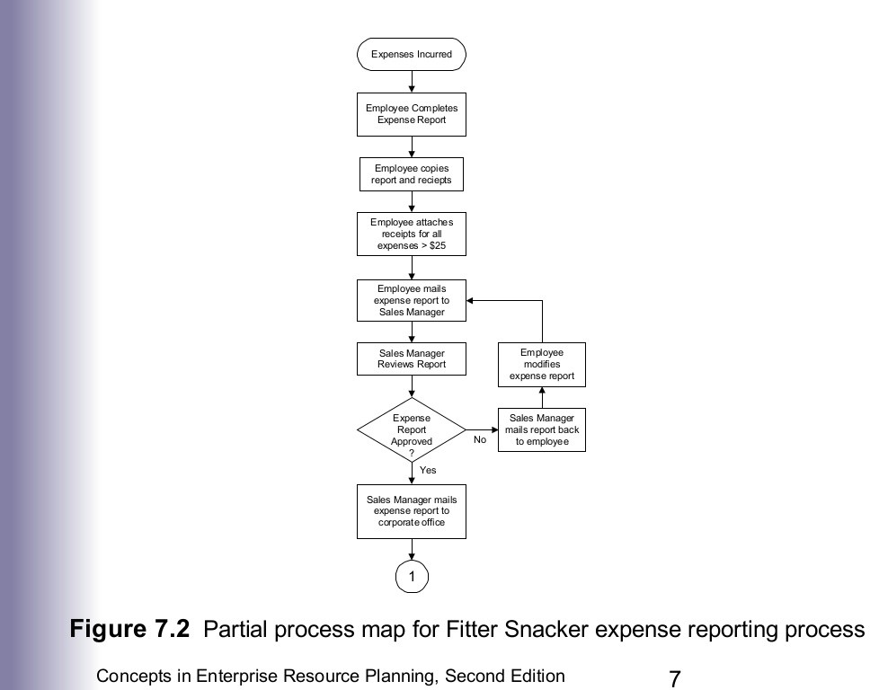

Slide 8
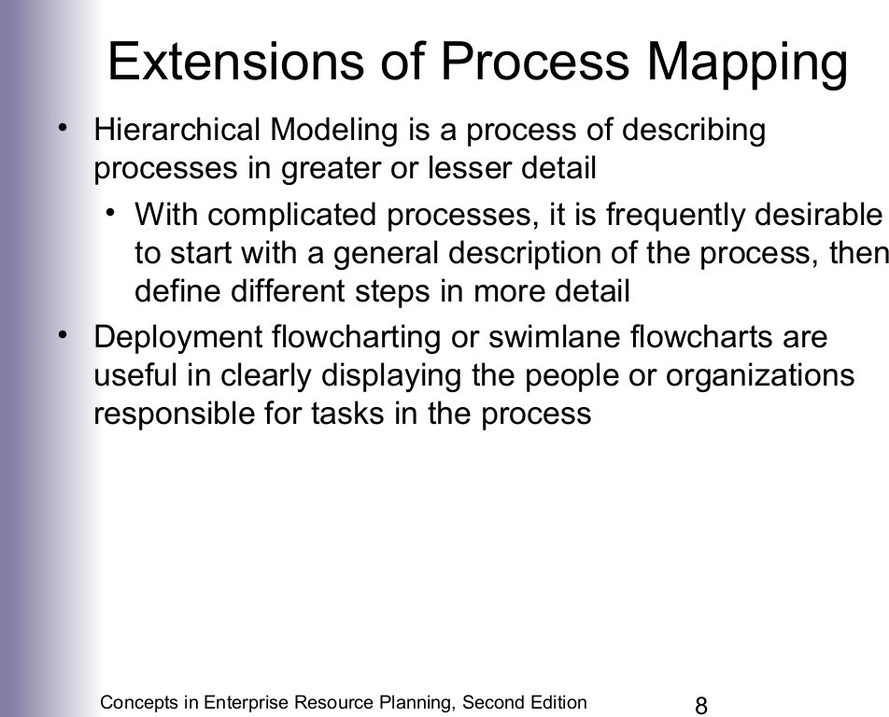

Slide 9
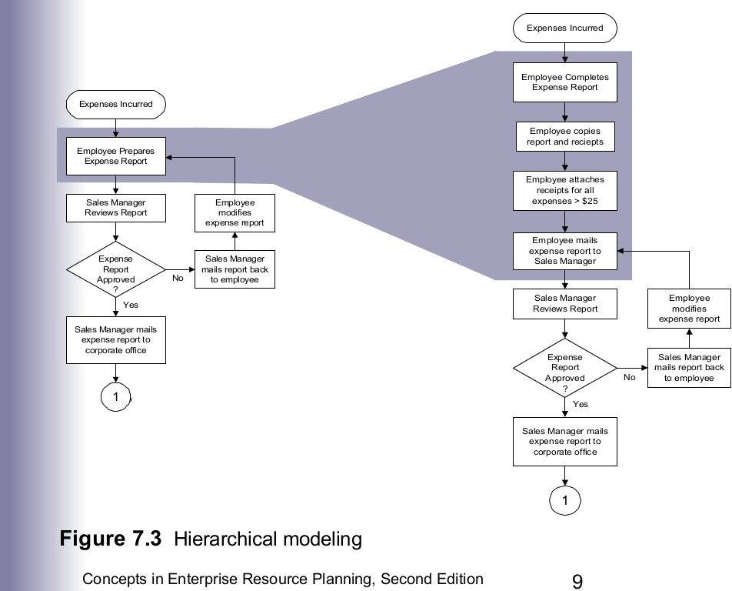

Slide 10
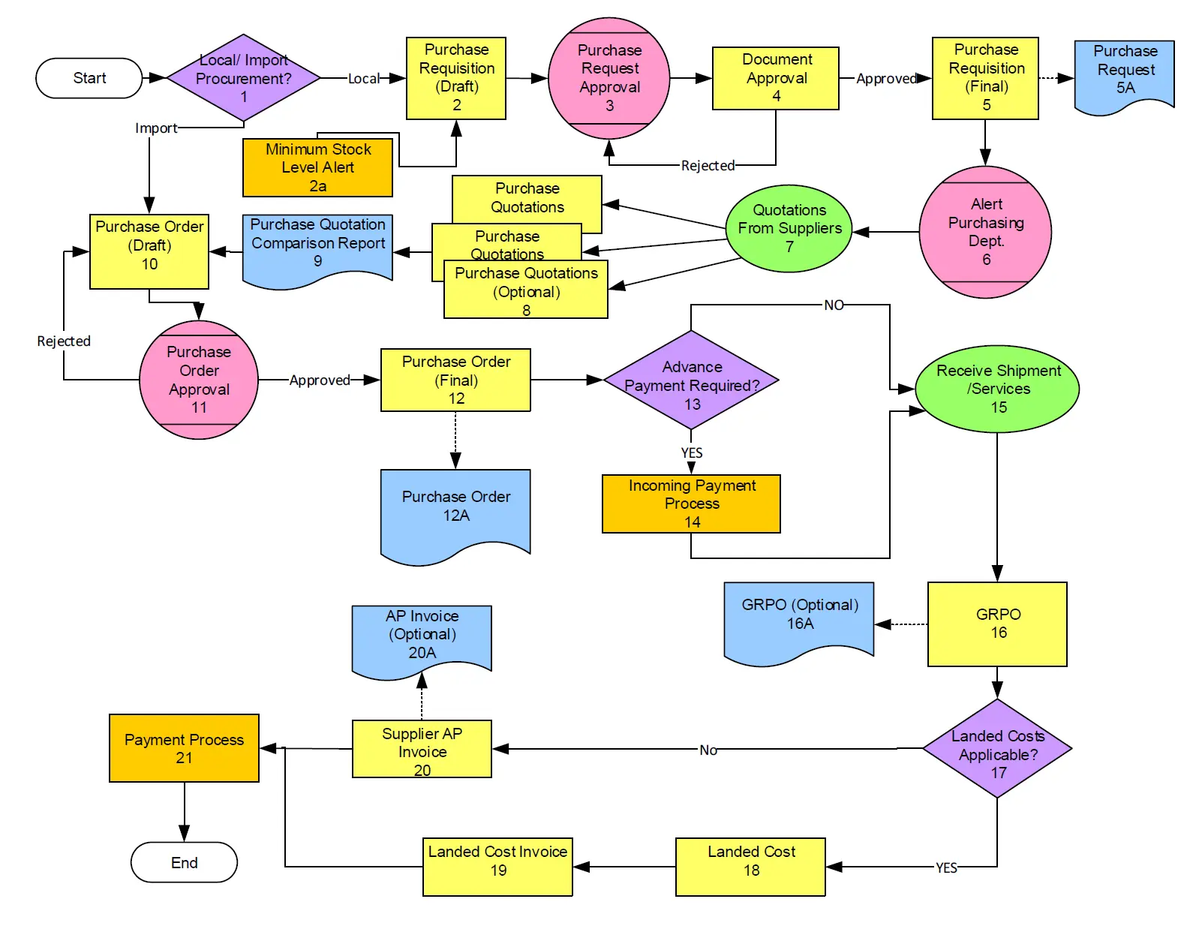
Notes:
This flowchart illustrates the end-to-end procurement process within an SAP ERP system, starting from determining the type of procurement (local or import) to the final payment to the supplier. It covers key stages such as purchase requisition creation, approval workflows, purchase order generation, goods receipt, invoice processing, and payment execution, providing a comprehensive overview of the materials procurement cycle.

Slide 11
Swimlane Diagram
A Swimlane diagram is a type of process flowchart that visually separates the steps of a business process into lanes, where each lane represents a functional area, role, or department.
✅ Clarifies responsibilities – Shows who does what in a process
✅ Improves communication – Makes cross-department workflows easy to understand
✅ Highlights inefficiencies – Identifies delays, redundancies, or handoff issues
✅ Simplifies process design – Helps in mapping ERP workflows and integration points
✅ Supports training and documentation – Easy for staff and students to follow the end-to-end process

Slide 12
Swimlane Diagram
Step by Step:
Step 1: Identify the Process
Define the overall business process you want to visualize.
Step 2: Identify the Functional Areas (Lanes)
Decide the departments/actors involved in the process. These will each have their own lane in the diagram.
HR Department
Finance Department
IT Department
New Employee
Step 3: List the Key Activities or Tasks
Break down the business process into sequential tasks by each functional area.
HR: Interview candidate, send offer letter
Finance: Register for payroll
IT: Set up email and system access
Step 4: Choose a Diagramming Tool
You can use tools like:
Draw.io
Lucidchart
Microsoft Visio
Step 5: Create Swimlanes
Draw horizontal or vertical lanes, one for each department or actor.
Label each lane clearly.
✳️ Example Lanes:
✳️ Example: Employee onboarding process that involves HR, IT, and Finance.
✳️ Example Tasks:

Slide 13
Swimlane Diagram
Step 6: Add Start and End Points
Use oval shapes to indicate where the process starts and ends.
Step 7: Fill in Tasks (Processes)
Use rectangles for tasks or operations.
Place each task in the appropriate swimlane according to who performs it.
Step 8: Add Decision Points
Use diamond shapes to show decisions (Yes/No paths). ✳️ Example: “Is candidate background check successful?”
Step 9: Connect the Activities
Use arrows to show the flow of activities from one step to the next. Include cross-lane connections if tasks move between departments.
Step 10: Review for Clarity and Completeness
Ensure the diagram is easy to read, and all actors, tasks, decisions, and flows are properly shown.

Slide 14
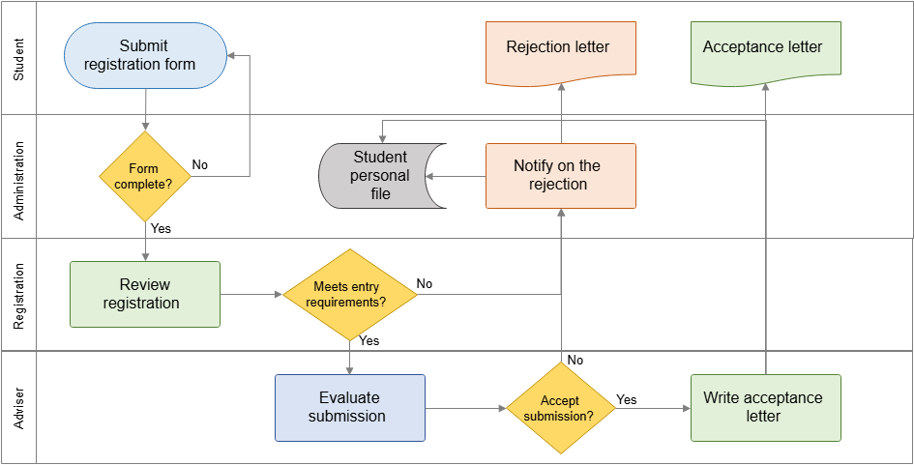
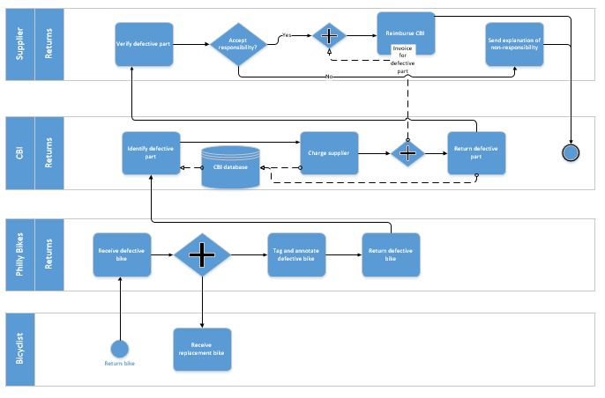

Slide 15
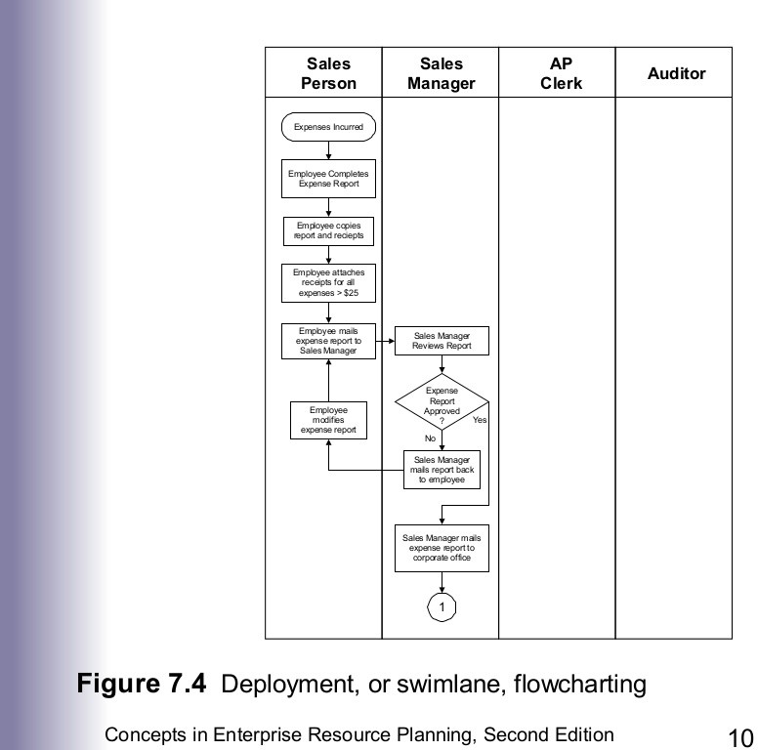

Slide 16
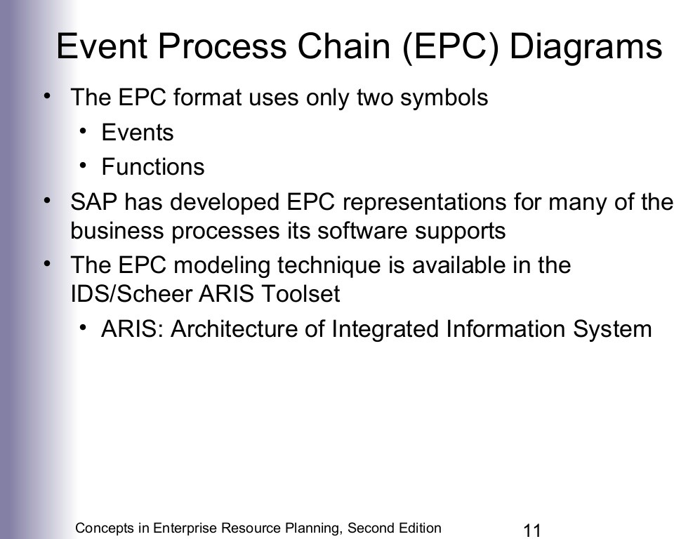

Slide 17
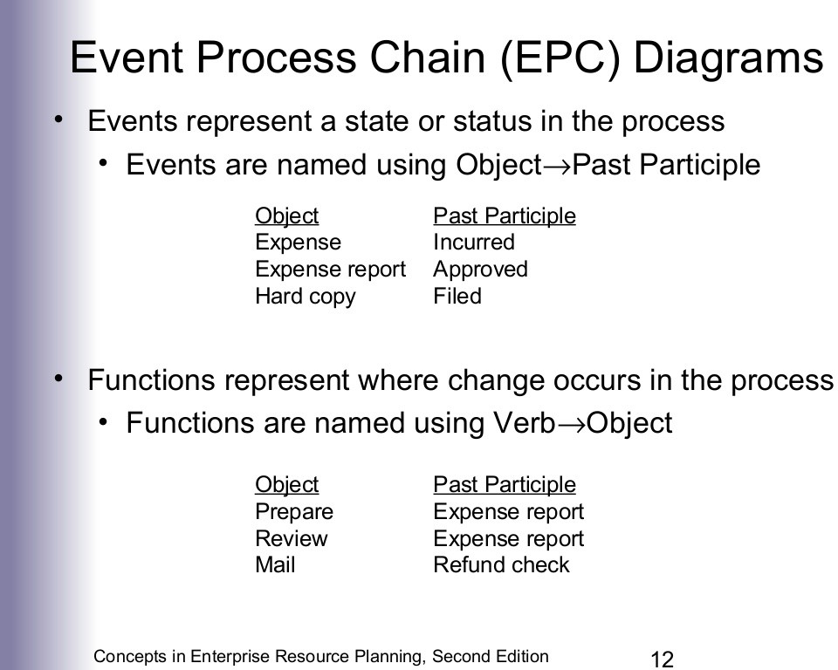

Slide 18
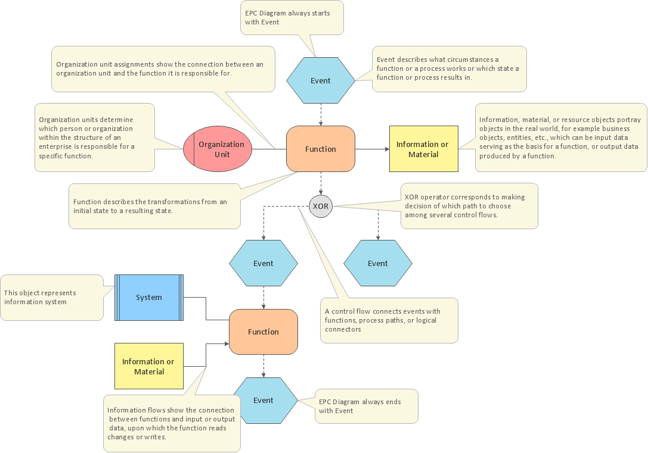

Slide 19
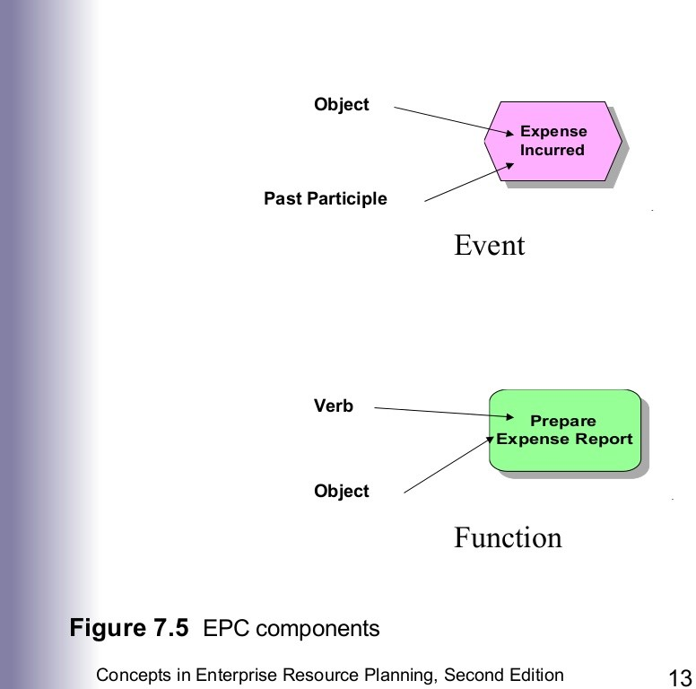

Slide 20
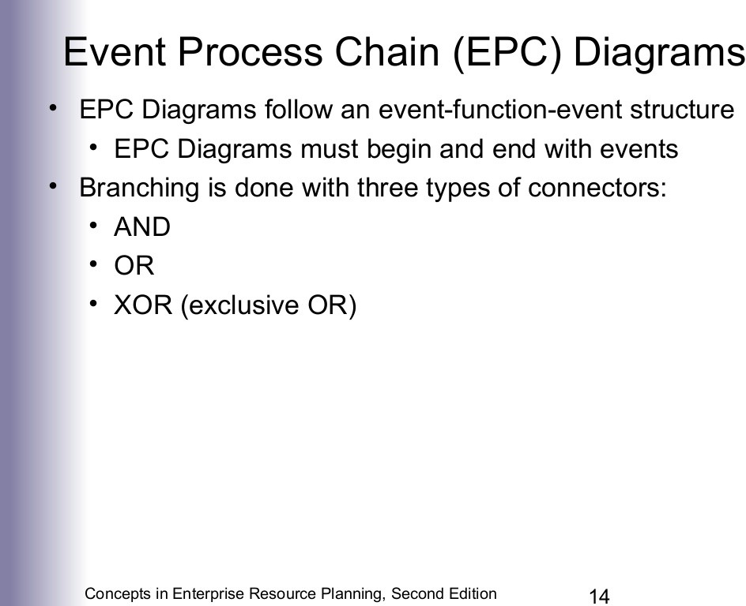

Slide 21
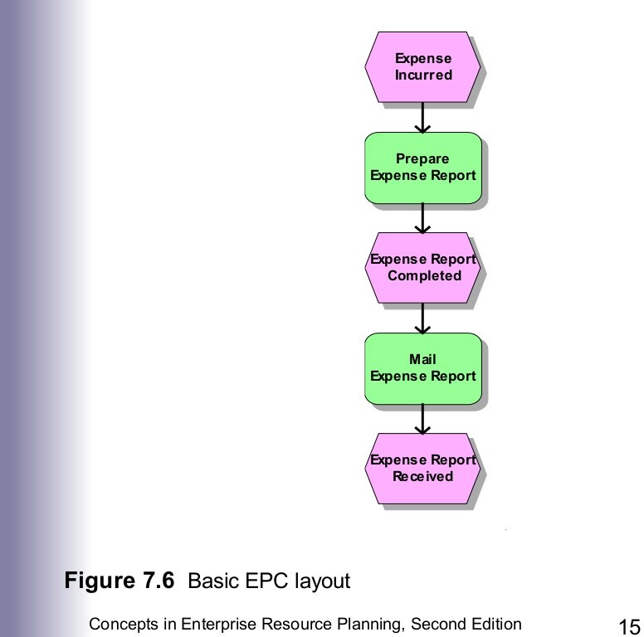

Slide 22
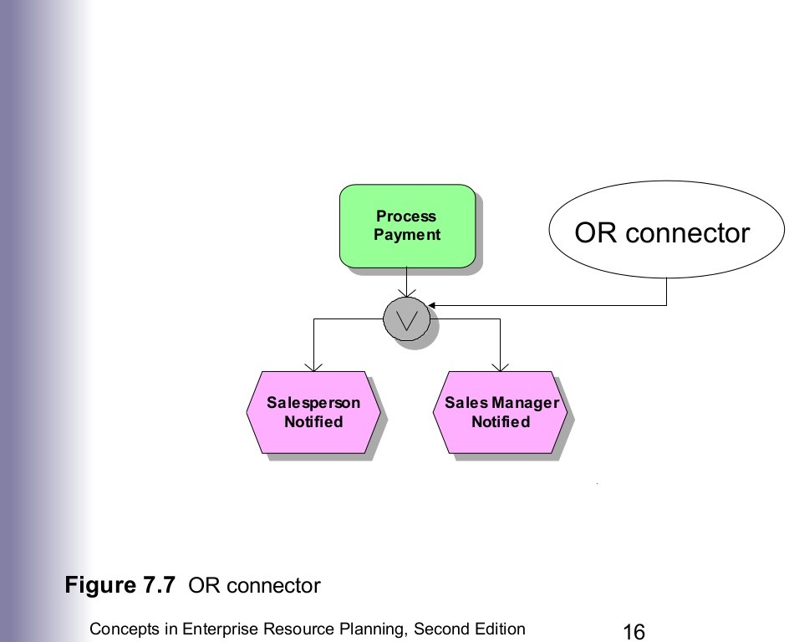

Slide 23
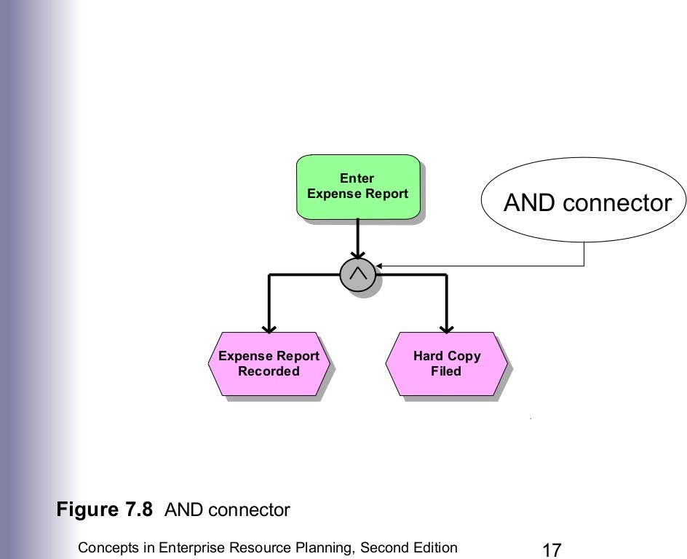

Slide 24
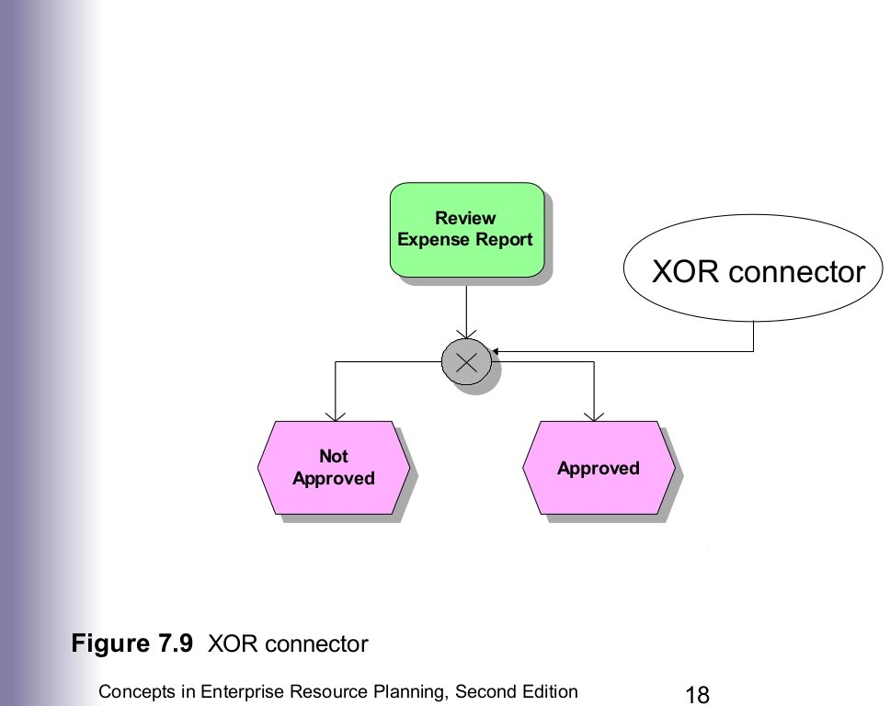

Slide 25
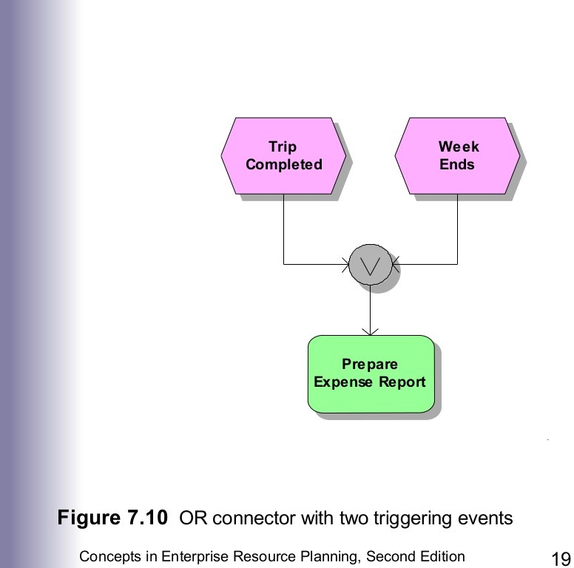

Slide 26
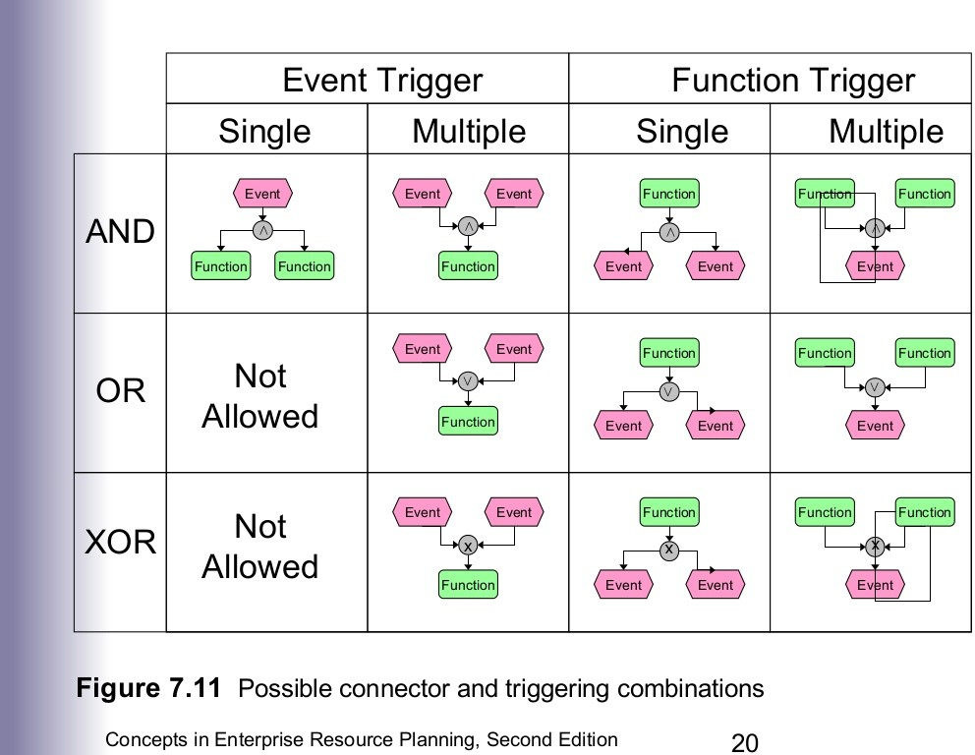

Slide 27
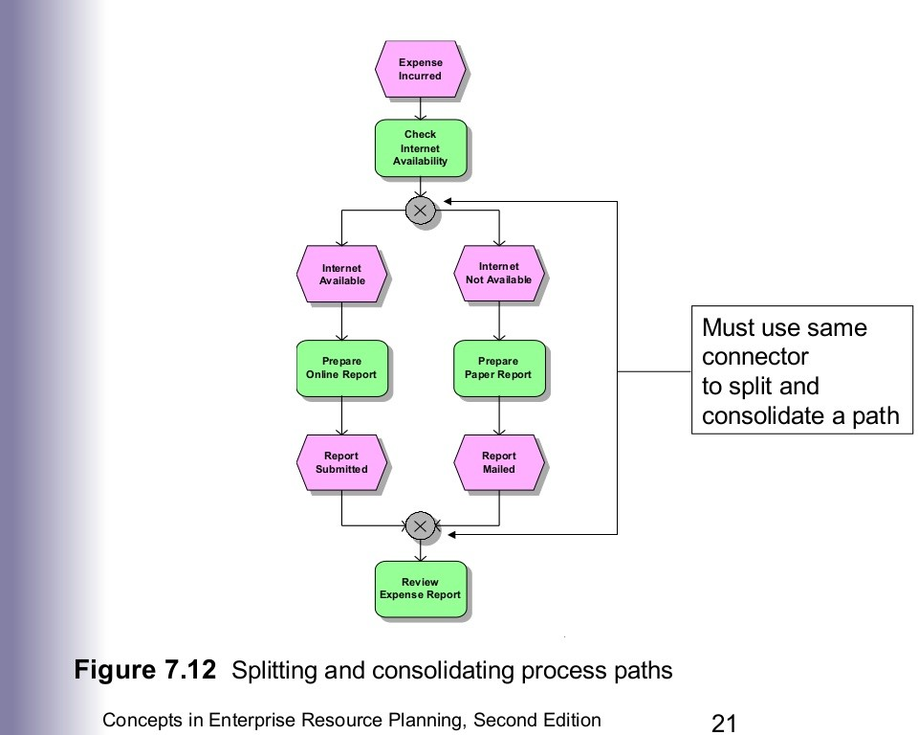

Slide 28
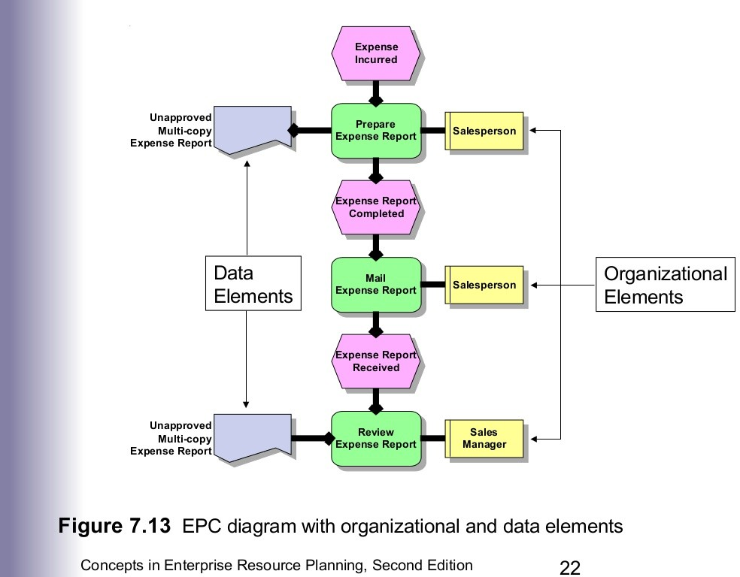

Slide 29
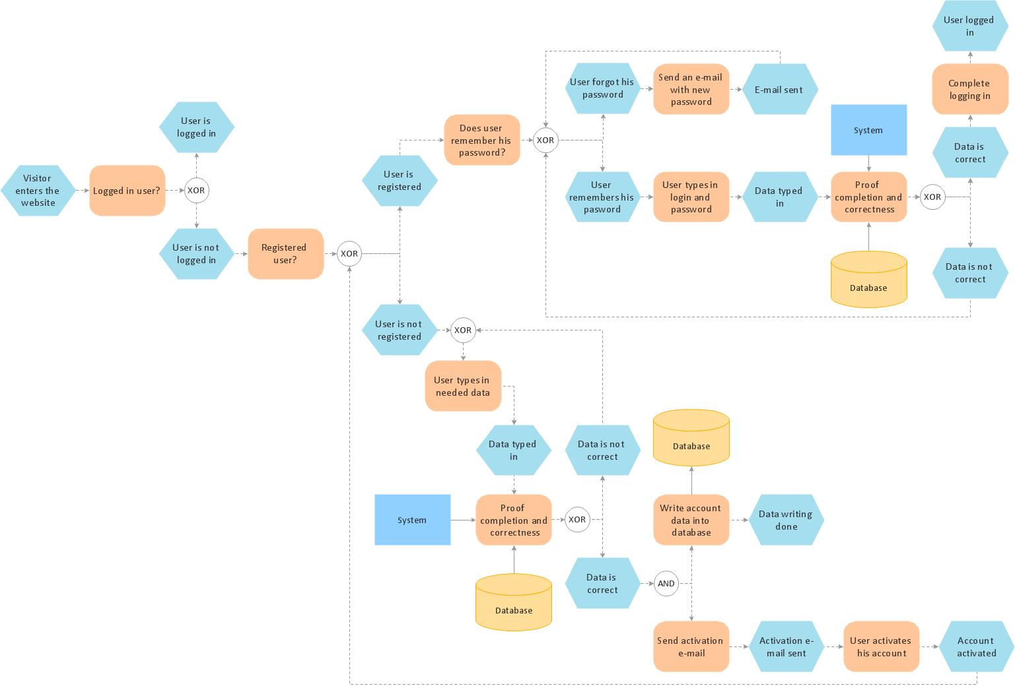

Slide 30
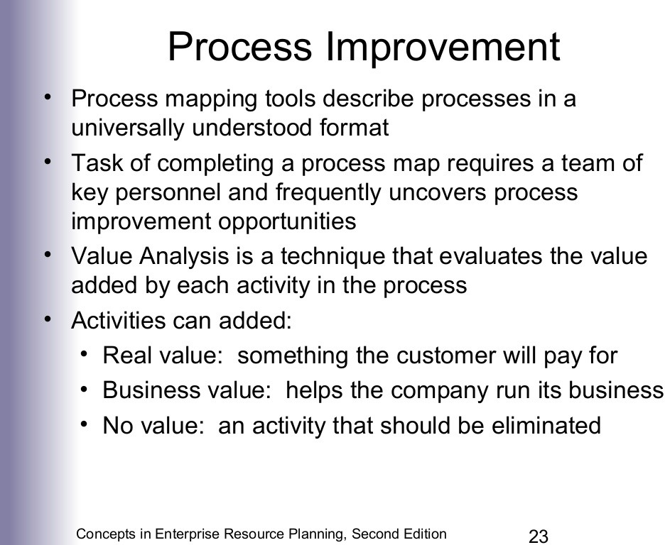

Slide 31
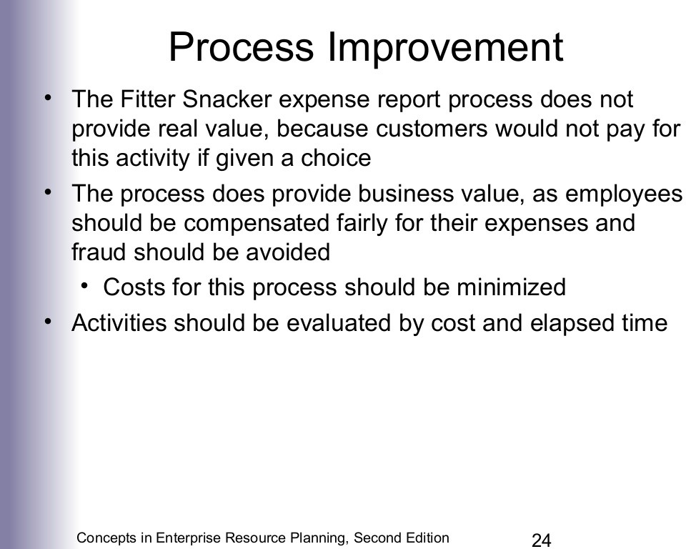

Slide 32
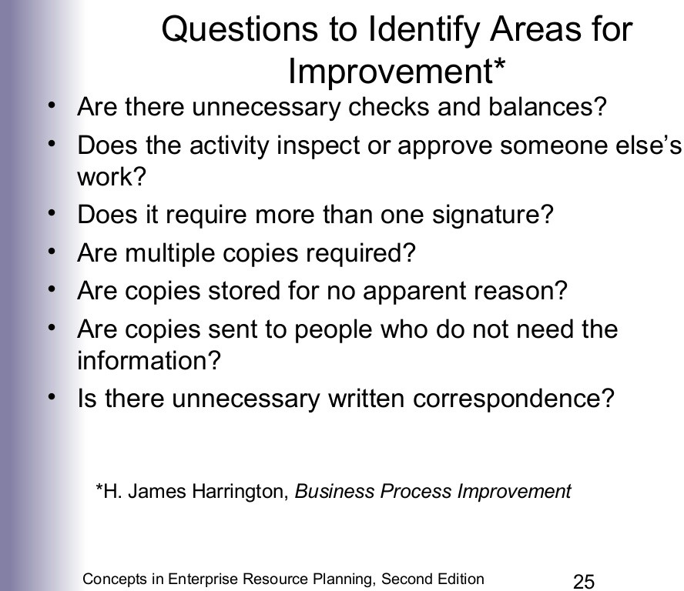

Slide 33
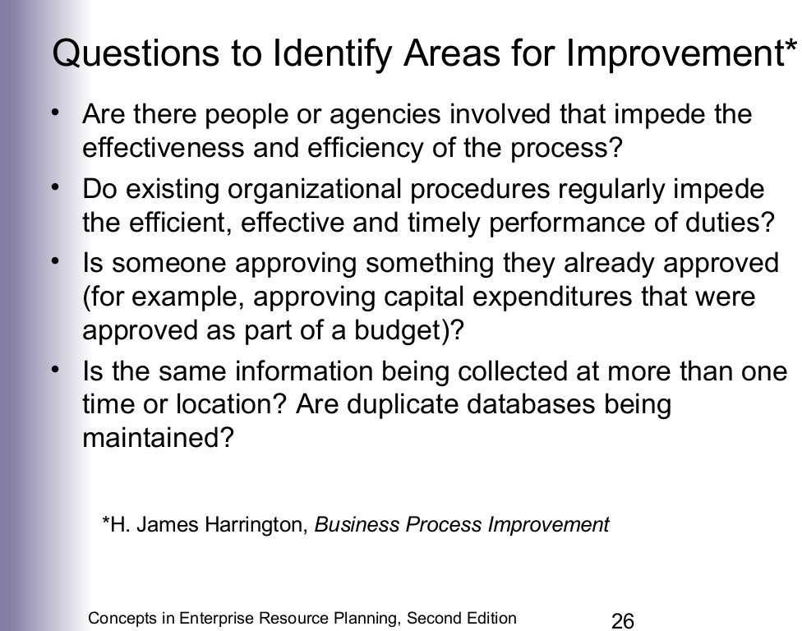

Slide 34
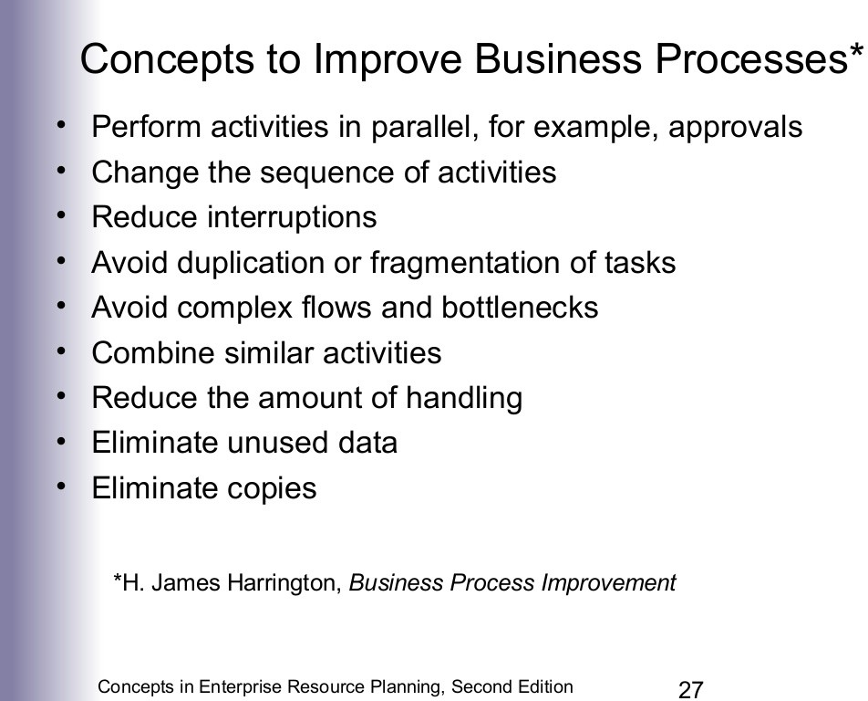

Slide 35
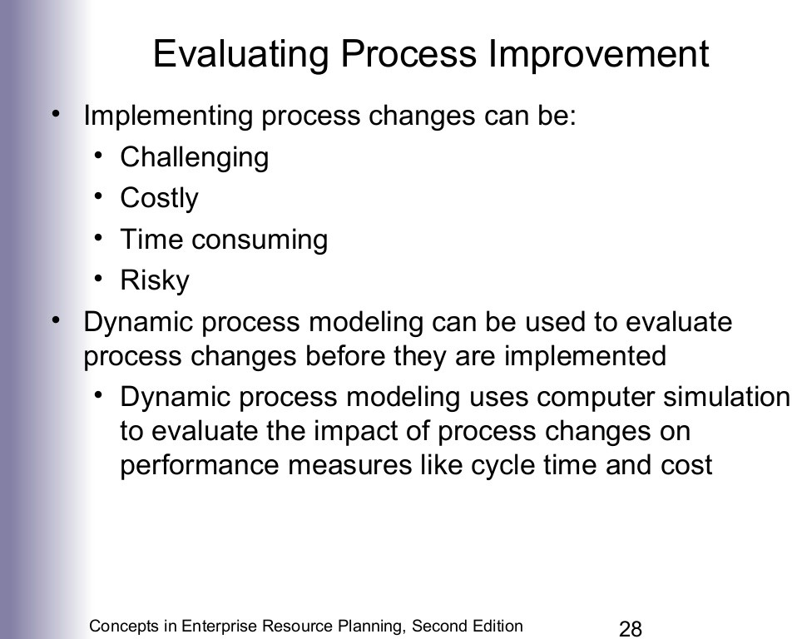

Slide 36
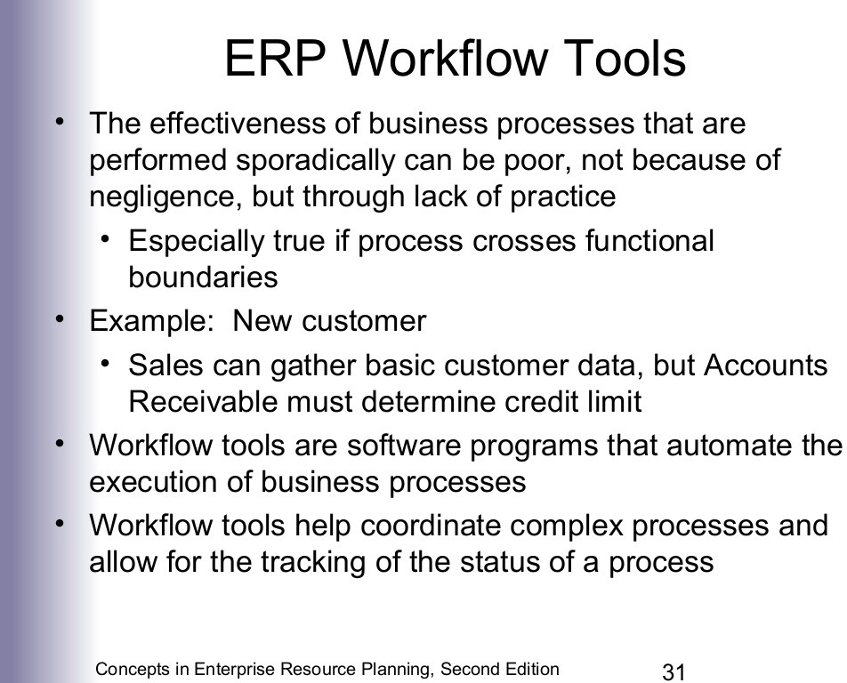

Slide 37
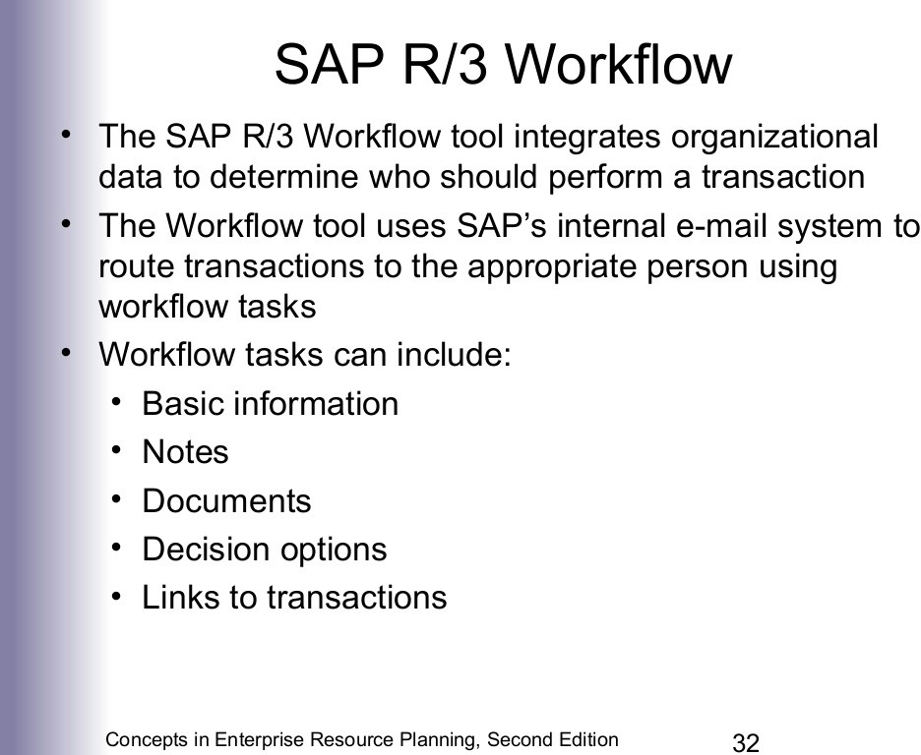

Slide 38
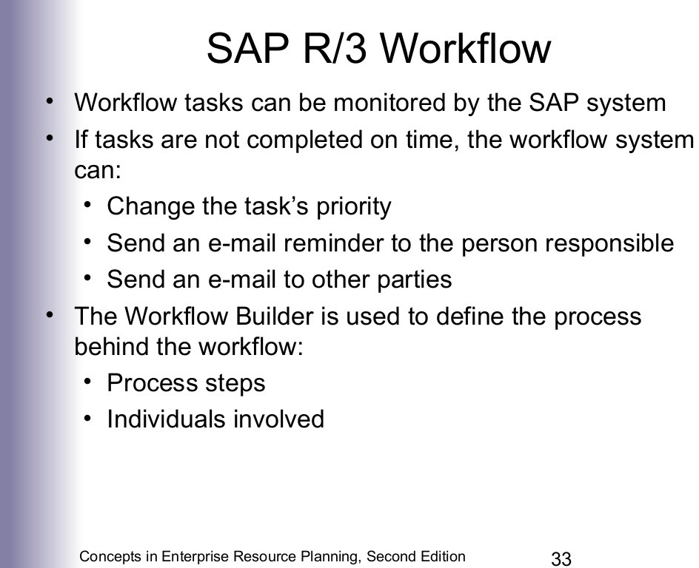

Slide 39
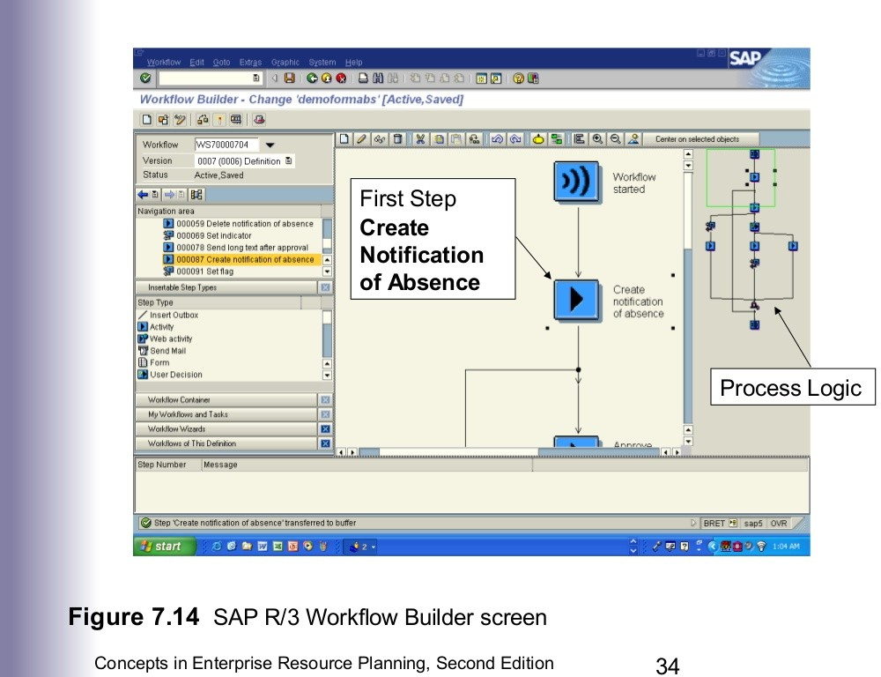

Slide 40
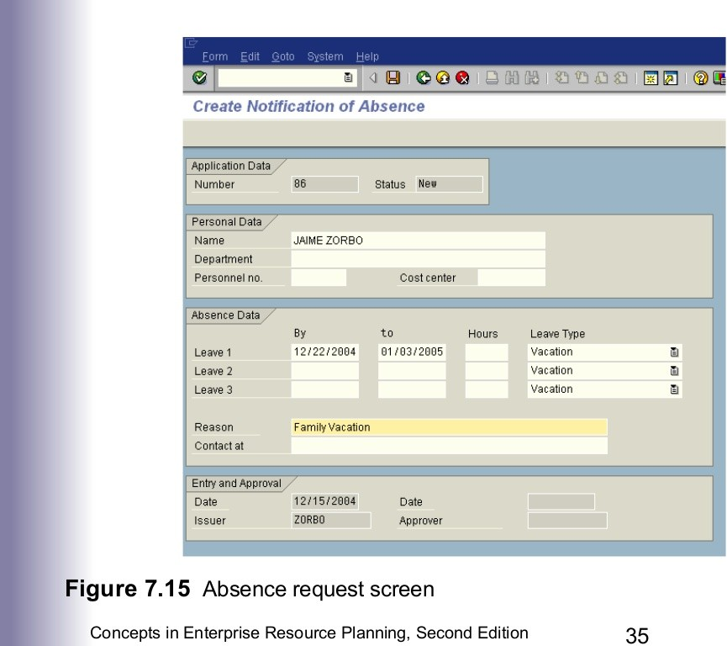

Slide 41
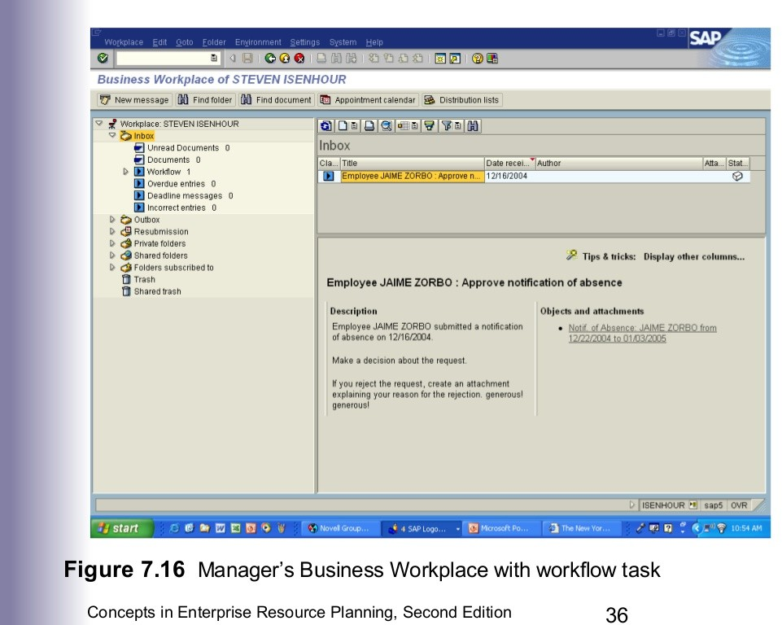

Slide 42
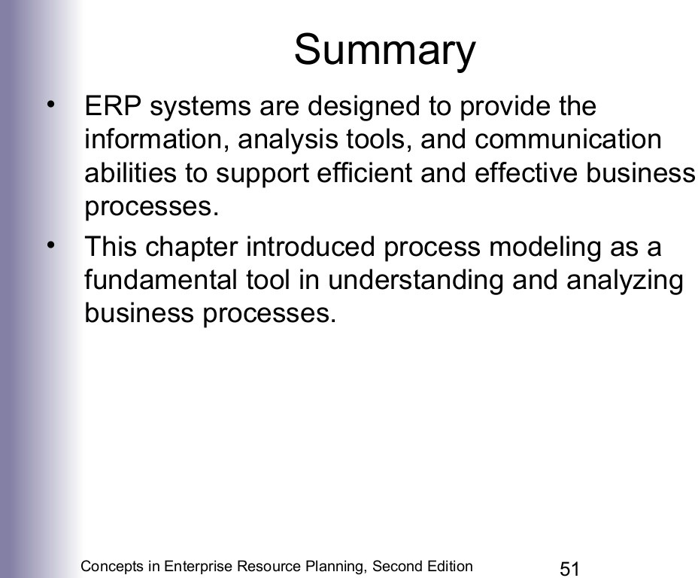

Slide 43
